Slide 1


CODEBASICS VIRTUAL INTERNSHIP PROJECT
SHIELD INSURANCE

Slide 2
AGENDA
COMPANY BACKGROUND
PROBLEM STATEMENT
PROJECT OVERVIEW
INSIGHTS
DASHBOARD SHOWCASE

Slide 3
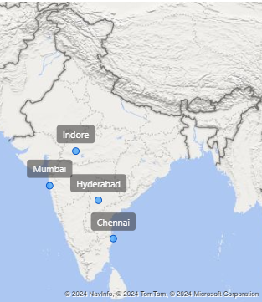
COMPANY BACKGROUND
OPERATIONS
Shield Insurance currently operates in 5 major Indian cities: Delhi NCR, Mumbai, Hyderabad, Chennai, and Indore.

Slide 4
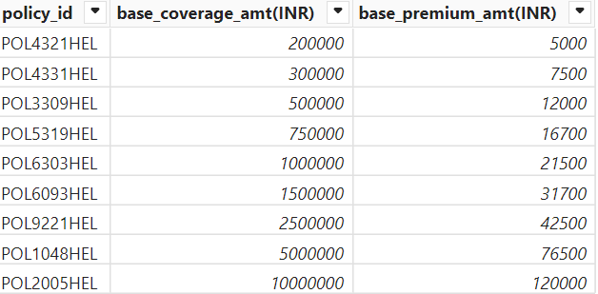
COMPANY BACKGROUND
PRODUCT OFFERINGS
They offer 9 distinct types of insurance policies, catering to a diverse range of customer needs.

Slide 5

COMPANY BACKGROUND
SALES MODES
Shield Insurance leverages 4 distinct sales modes: Offline Agent, Offline Direct, Online App, and Online Website.

Slide 6
PROBLEM STAEMENT
UNDERSTANDING CUSTOMER BASE
REVENUE ANALYSIS
POLICY ANALYSIS
Tracking total revenue generated, analyzing revenue growth rates, and identifying revenue trends.
Monitoring changes in policy performance on a month-over-month basis, identifying areas for improvement.
Determining the total number of customers and analyzing customer growth trends over time.

Slide 7
PROJECT OVERVIEW
OBJECTIVE
DATA SETS
Conduct a comprehensive analysis of customer and revenue data, focusing on sales modes and age group impact.
Utilize various data sets, including dim_Customers, dim_date, dim_Policies, Fact_Premiums, and Fact_Settlement.
1
2
3
4
FOCUS
DATA CORRECTIONS
Main Focus on Sales_Mode_Analysis and Age_Group_Analysis.
Ensure data integrity by modifying date datatypes, formats, and age group classifications.

Slide 8
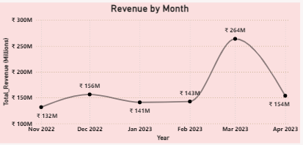
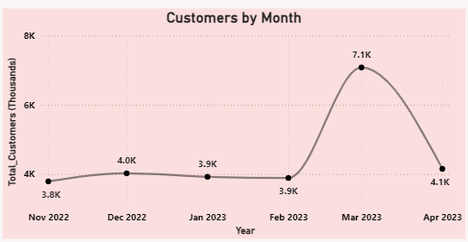
INSIGHTS
Revenue peaked at ₹264M in March 2023, followed by a decline to ₹154M in April 2023. The trend shows fluctuating revenue over these months
March: 7.1K customers (highest peak)
Other months: Stable around 3.8K to 4.1K customers
March sees a significant surge in customers compared to other months.

Slide 9
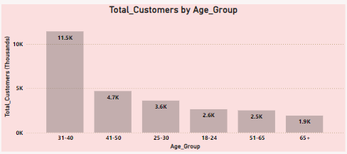
INSIGHTS
The age group 31-40 dominates 11.5K customers the highest and 65+: 1.9K customers the lowest customer base.

Slide 10
DASHBOARD
CLICK HERE TO DASHBOARD

Slide 11


THANKYOU
HEMANAND SIR
DHAVAL PATEL SIR

